Slide 1
Progress Report 4
Sprint 4 - (3/4 - 3/11)
Updated on 3/13
Brian Goughnour, Josh Brown, Steve Stamey, Guylain Kibunzi, Chauncey Davidson

Slide 2
Sprint Backlog - Responsibilities
Charles Stamey - Hot bar implementation. Background and additional button designs
Guylain Kibunzi - GUI implementation, Building app for iPhone
Joshua Brown - GUI implementation, Building app for Android, One Dial backend
Brian Goughnour - Working on Goal Tracker
Chauncey Davidson - Implement Database API (along with CSV files for event information), finish Hot Dial

Slide 3
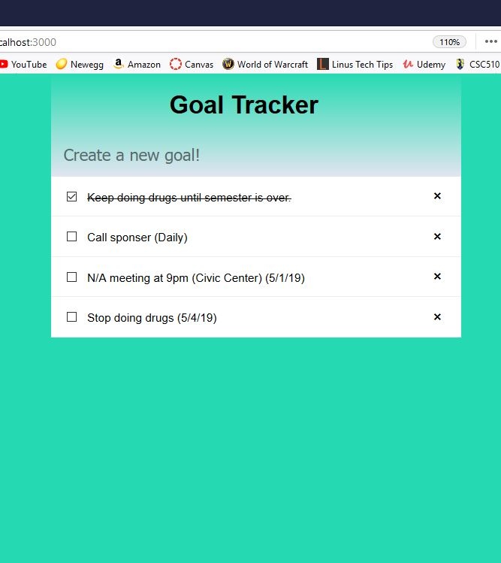
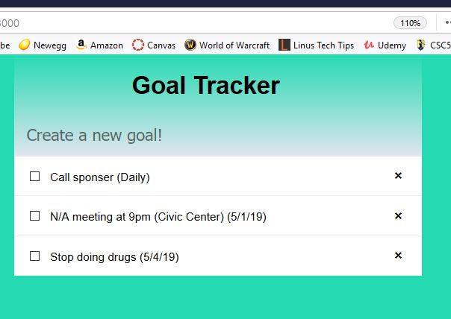
Goal Tracker (Basic UI)

Slide 4
Goal Tracker (For next sprint)
Add files to the rest of the project and verify that it works
Clean the UI for better interface with iOS, and Android

Slide 5

Mock-up
Main Page

Slide 6
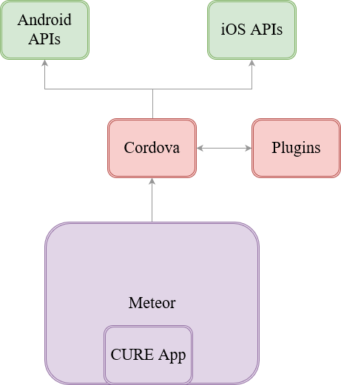
LEGEND
Phone Services
Cordova Services
Meteor API

Slide 7
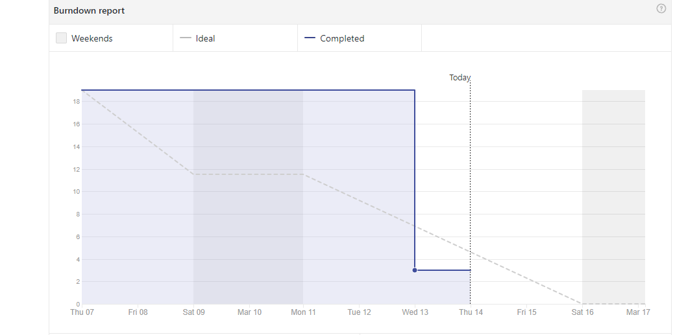
Burndown Report (Last Sprint)

Slide 8
Future Sprint
Begin implementation of the Calendar subsystems
Embark on Location Services subsystems
Finish back end database and Hot Dial GUI

Slide 9
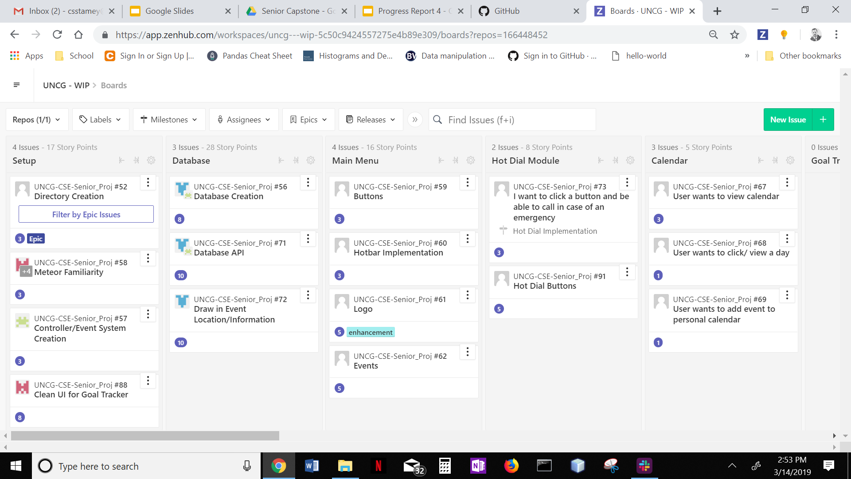
ZENHUB

Slide 10
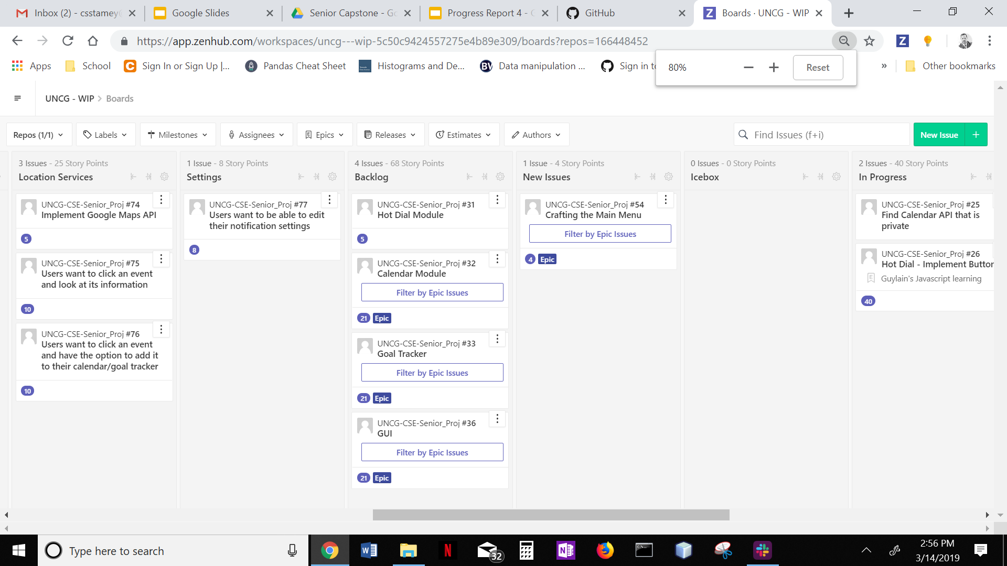
ZENHUB

